Slide 1
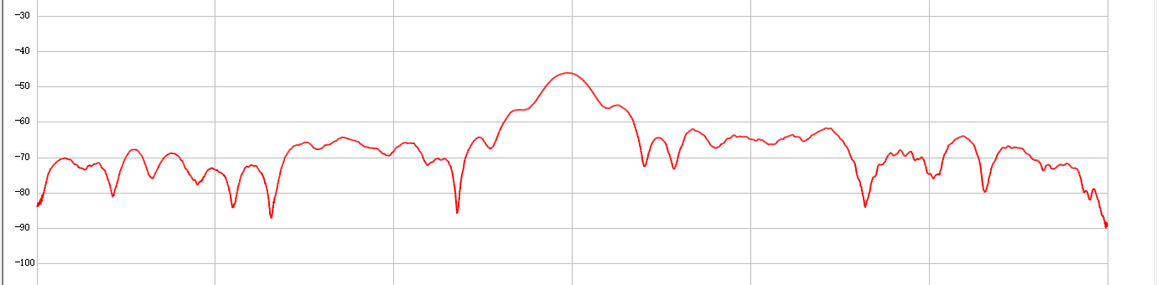
RIS-based antenna: Antenna performance
RIS-based antenna
RIS + feed (horn antenna)
Capable of beam sweeping, just like the phased array
More energy and cost efficient than conventional phased array
Performance indicator
Sidelobe level: difference between the strongest sidelobe and the main lobe
Beam steering precision: the deviation of the main lobe from the desired direction
Sidelobe level

Slide 2
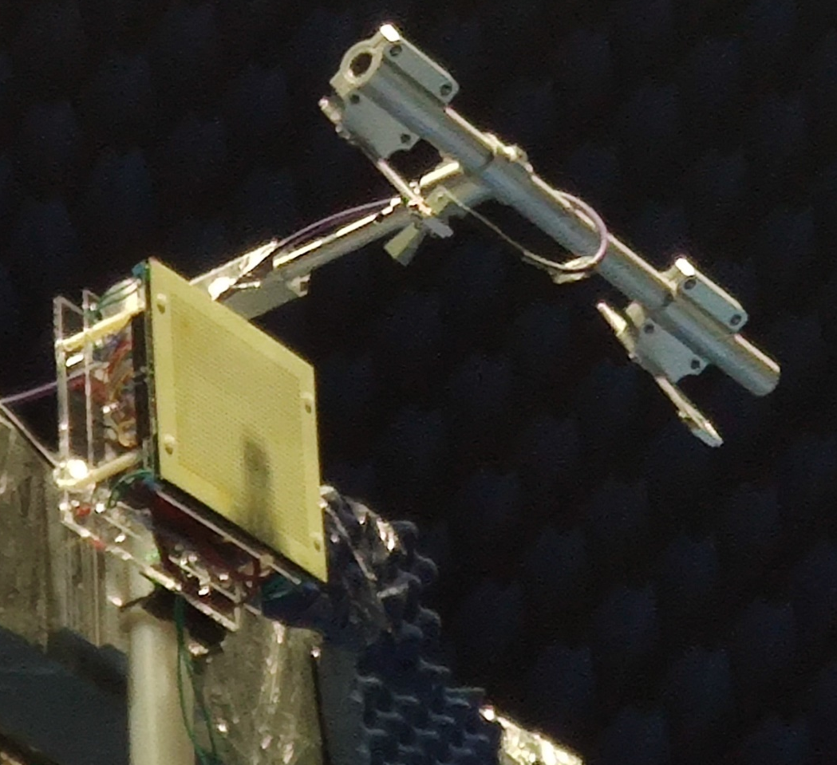
RIS-based antenna: Antenna performance
Implemented RIS-based antenna
RIS: 32*32 elements, 1bit, 25~27GHz
Feed: horn antenna LB-34-10-C-KF, 10 dBi
Feed
RIS

Slide 3
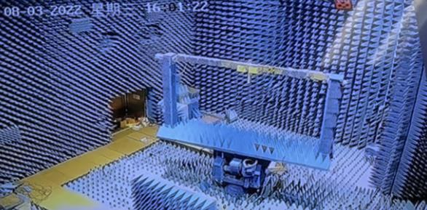
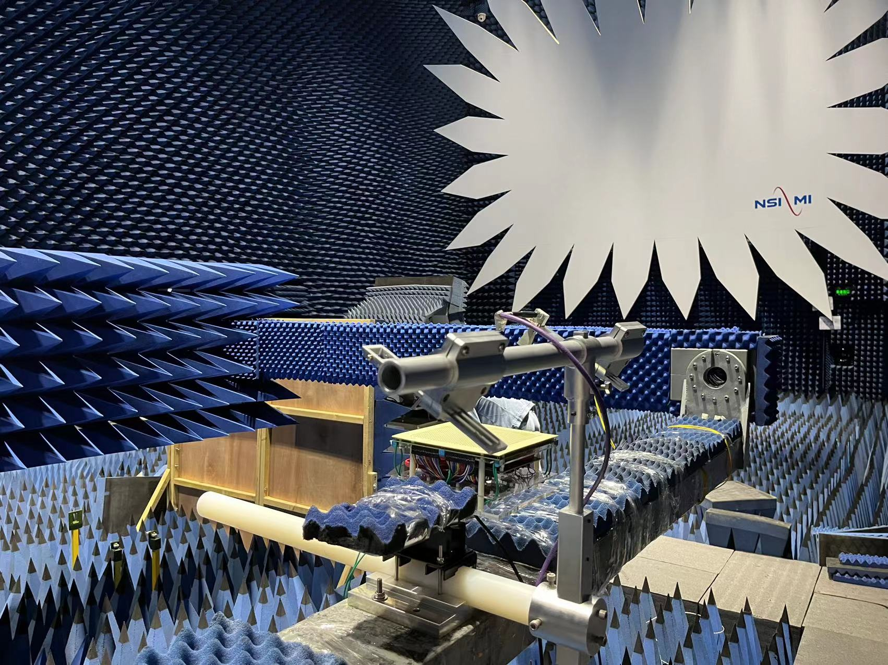
RIS-based antenna: Antenna performance
Experimental setup
Test the antenna within an anechoic chamber in order to measure the performance metrics accurately
Turn table for supporting RIS-based antenna
Spherical-to-plane wave transformation plate

Slide 4
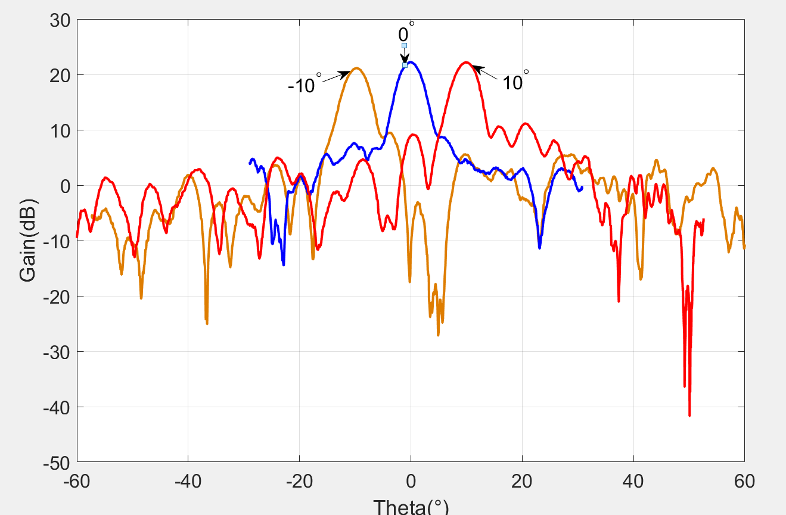
RIS-based antenna: Antenna performance
Experimental results
Sidelobe level
Beam steering precision
Beam direction (degree) | -10 | 0 | 10
SLL (dB) | -14.5 | -14.2 | -12.2
Target Beam direction (degree) | -10 | 0 | 10
Deviation (degree) | 0.66 | 0 | 1.08

